Slide 1
Image Captioning with Semantic Attention
Team: WYD Step Size

Slide 2
Team Members:
Varun Chhangani (2019121011)
Aman Kumar Kashyap (2019121010)
Vaishali Singh (2020201070)

Slide 3
About the Problem
Automatically generating a natural language description of an image, a problem known as image captioning. Generating a meaningful natural language description of an image requires a level of image understanding that goes well beyond image classification and object detection.
The problem is interesting not only because it has important practical applications, such as helping visually impaired people see, but also because it is regarded as a grand challenge for image understanding which is a core problem in Computer Vision.
The problem is also interesting in that it connects Computer Vision with Natural Language Processing which are two major fields in Artificial Intelligence.
There are two general paradigms in existing image captioning approaches: top-down and bottom up. The top-down paradigm starts from a “gist” of an image and converts it into words, while the bottom-up one first comes up with words describing various aspects of an image and then combines them.
The paper proposes a new image captioning approach that combines the top-down and bottom-up approaches through a semantic attention model. The semantic attention in image captioning is the ability to provide a detailed, coherent description of semantically important objects that are needed exactly when they are needed.
Both the methods have problems of their own, such as lack of end-to-end integration in bottom-up approach, and details being missed out in top-down approach.

Slide 4
Weekly Plan
Setting up VGGnet
LSTM for text output
Attention Model
Attribute Detection
Evaluation

Slide 5
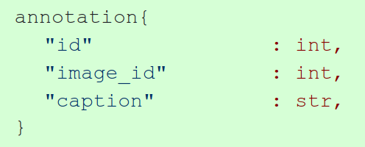
Dataset Description
Datasets used:
Flickr30k
5 Captions provided for each of the train 30,000 images.
MS-COCO 2014
The annotations are stored using JSON. Please note that the COCO API described on the download page can be used to access and manipulate all annotations. All annotations share the same basic data structure below.
Each image has at-least 5 captions, some have more.

Slide 6
Method of Approaching the Problem
Image captioning requires observation of patterns and objects in the given image, and thus we need to extract the attributes present in the image.
The textual output needs us to have a RNN model at the output, for which we are going with LSTM.
We also need to have some relationships between the objects visible to us and also sometimes need to focus more on something and ignore few things.
We need to focus on only the subject of the image, as we know “A picture is worth thousand words” but we have to have a bound on the length of the caption. For this reason, we are going with attention models at both input and output.

Slide 7
Method of Approaching the Problem
Provide a syntactically correct and meaning description given an image.
Use CNN to extract image features in context of classification.
Further use this feature vector to initialize the LSTM state.
Create input at each time using the previously generated word and the visual attribute extracted by the attribute detector.
Use input and output attention model to generate captions.
Use regularization to prevent overfitting.
Finally evaluate using various metrics.

Slide 8
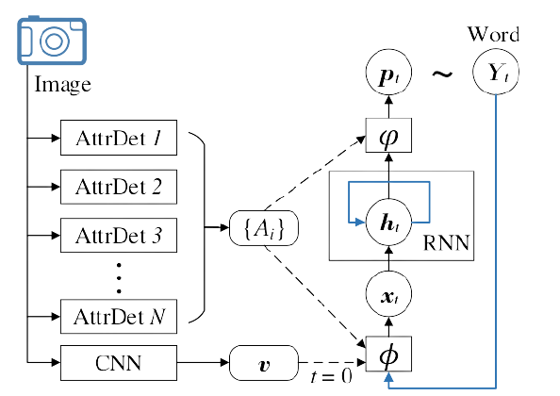
Method of Approaching the Problem

Slide 9
Goals for Mid and Final Eval
Mid Eval:
A basic model without Attribute and Attention, using ResNet50 for CNN and LSTM for RNN.
Final Eval:
GoogleNet for CNN and Attribute Detection, LSTM for RNN and Input and Output attention for the RNN.
The results will be evaluated for metrics like BLEU, CIDEr, METEOR, etc.

Slide 10
Work Division
Till Mid eval:
Aman Kumar Kashyap: Dataset and Dataloader
Vaishali Singh: Encoder CNN
Varun Chhangani: LSTM RNN
Further division till End eval (tentative):
Aman Kumar Kashyap: Attention Model
Vaishali Singh: Attribute Detection
Varun Chhangani: Evaluation and Integration

Slide 11

Thank You

